Slide 1
Given Enough Monkeys
Some Thoughts on Randomness
Jesse Anderson | Cloudera, INSTRUCTOR

Slide 2

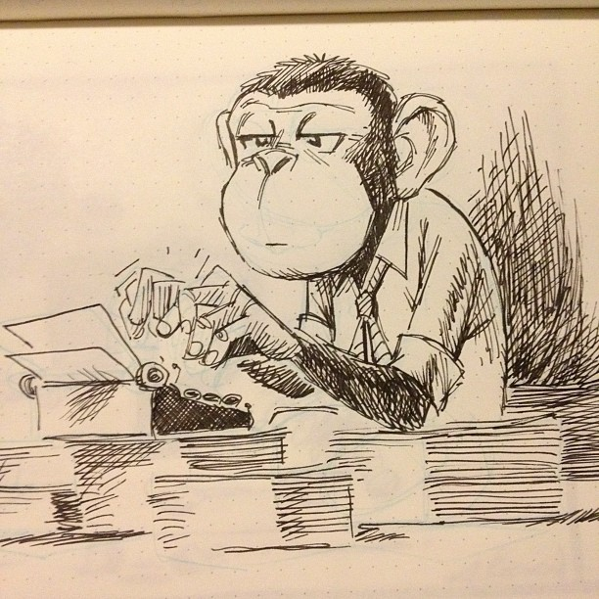
Infinite Monkey Theorem
“
A million monkeys on a million typewriters will eventually recreate Shakespeare
”
Notes:
Interesting statistical question. Thought about since Aristotle.
Randomness+Resouces+Time=Anything Possible
No real monkeys – need virtual monkeys

Slide 3
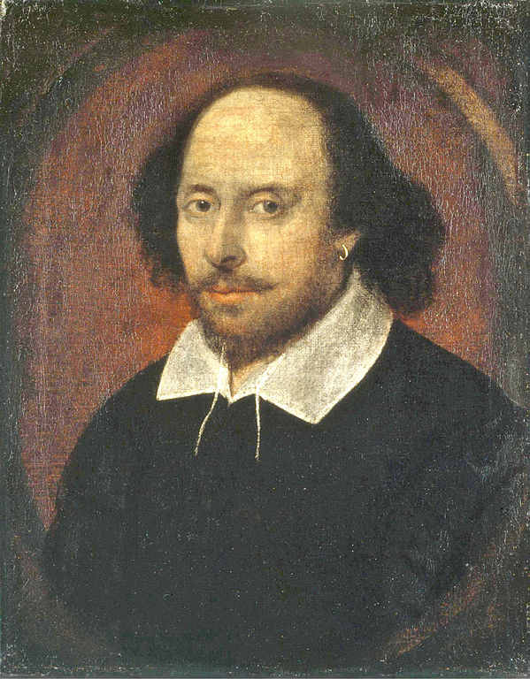
Million Monkeys Algorithm
Randomly generate a 9 character group
TOBEORNOT
Does it exist in Shakespeare?
To be, or not to be- that is the question
Notes:
Lucky monkey
The monkey wears a lot of hats. He generates and then compares.
Every work of Shakespeare created. First was A Lover’s Complaint and last was Taming of the Shrew
Visualization to find your favorite line from Shakespeare

Slide 4
Exponential Growth (aka Big Data)
Contiguous Characters | Combinations
8 | 208,827,064,576
9 | 5,429,503,678,976
10 | 141,167,095,653,376
Odds of finding a group of characters is 1 in 26 raised to the power of the number of contiguous characters
1 in 26^{n}
Notes:
Shakespeare lazy. Heavily influenced English Literature.
Big Data isn’t always a huge file. It can be high computation.

Slide 5

Data Bias?
Notes:
Creating Shakespeare not a business. Don’t have Shakespeare in your data. If you look hard enough you will find it
Humans are not random
You want to be looking for what’s actually there. Check your assumptions
Operate with scientific method. Form a hypothesis. Test hypothesis against data.
Offer what customers are looking for. Not what you think or favorite or new product. Only what your data shows.

Slide 6
Hadoop Scalability
Nodes
RDBMS = Relational Database
Notes:
This is not a map of MT and ID
1 to 20 node testing
Keep efficiency up
RDBMS efficiency in gutter

Slide 7
Business Value of Scalability
Scaling does not require massive re-engineering
and complete rewrites of code
Adding more computers to cluster gets a predictable increase in computational power and storage
TIME
$$$
SAVE
SAVE
Notes:
Engineers not spending time coding to scale. Busy adding new features.
No code changes for scaling. Took 1.5 months on one computer and 3.5 days on 20 nodes
Spending on new computers gives a consistent, linear increase. Compare spending on RDBMS and Hadoop.

Slide 8

Going Viral (and taking over the world)
26,000 unique visits from 119 countries in one day
Covered internationally in BBC, Wall Street Journal, Wired and Slashdot

Slide 9

@jessetanderson
Notes:
We like to ask bigger questions.
I asked if Shakespeare could be randomly recreated by a bunch of virtual monkeys? The answer is yes.

